Slide 1
Unit-II
Levels of Testing

Slide 2
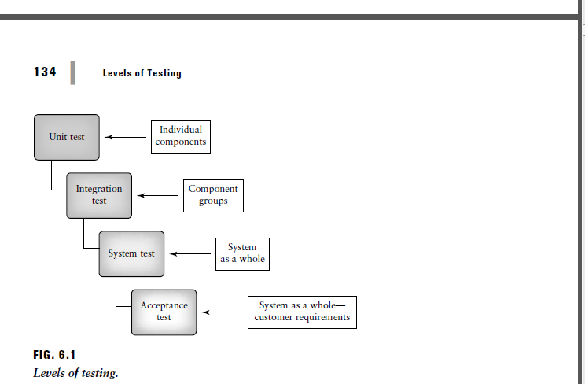

Slide 3
Execution-based software testing, especially for large systems, is usually carried out at different levels. In most cases there will be 3–4 levels, or major phases of testing: unit test, integration test, system test, and some type of acceptance test as shown in Figure 6.1.
Each of these may consist of one or more sublevels or phases. At each level there are specific testing goals.
For example
At unit test a single component is tested. A principal goal is to detect functional and structural defects in the unit.
At the integration level several components are tested as a group, and the tester
investigates component interactions.
At the system level the system as a whole is tested and a principle goal is to evaluate attributes such as usability, reliability, and performance.

Slide 4
Contents
1. Different levels of testing.
2. Important factors on testing levels.
o Factors influencing test scope
o Why test at different levels?
3. Test levels and software life‐cycle models.
o
“V” Model

Slide 5
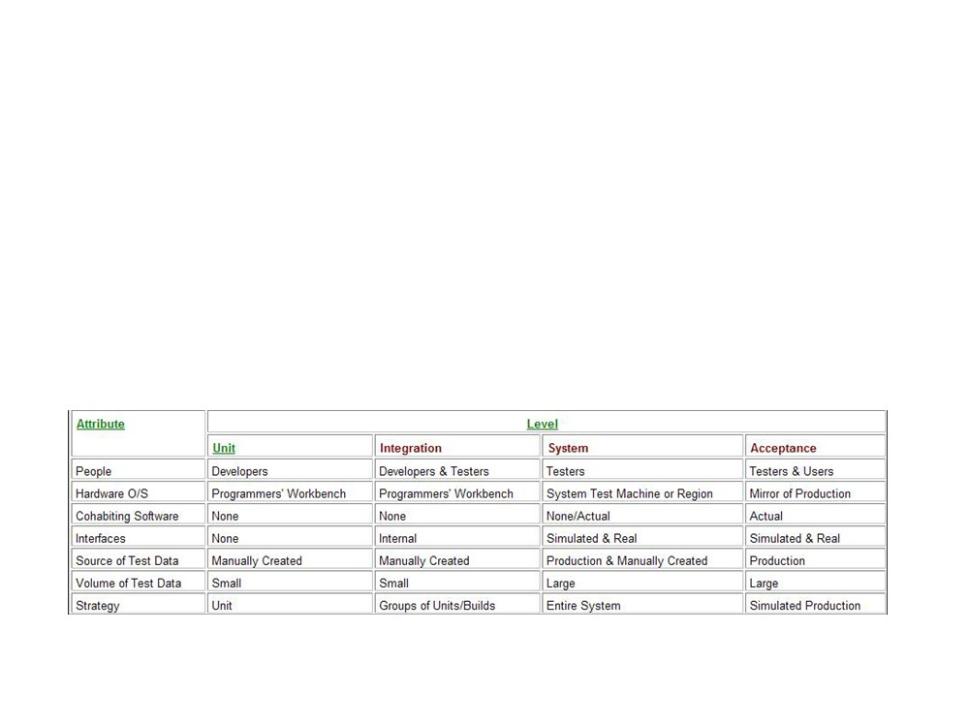
1. Different Levels of testing
What is a level of test?
• Defined by a given environment
• environment is a collection of people,
hardware, software, interfaces, data etc.
Fig 1 - Sample environment variables

Slide 6
1. Levels of testing
• Unit Testing
• Integration Testing
• System Testing
• Acceptance Testing
• Regression testing

Slide 7
Contents
1. Different levels of testing.
o Unit Testing
o Integration Testing o System Testing o Acceptance Testing o Regression Testing
2. Important factors on testing levels.
o Factors influencing test scope
o Why test at different levels?
3. Test levels and software life‐cycle models.
o
“V” Model

Slide 8
1.1 Unit Testing
• A unit is smallest testable piece of software
- can be compiled, linked, loaded
- e.g functions/procedures, classes, interfaces
- normally done by programmer
- Test cases written after coding
• Disadvantage
- Test cases ‐written to suit programmer’s
implementation (not necessarily specification)
• Better to use “Buddy Testing”

Slide 9
1.1 Unit Testing
Buddy Testing
• Team approach to coding and testing
• One programmer codes the other tests and vice versa
- Test cases ‐ written by tester(before coding starts). Better than single worker approach
• Objectivity
• cross‐training
• Models program specification requirement

Slide 10
1.1 Unit Testing
• Normally in programmers IDE (comfort zone)
• Find unit bugs
- Wrong implementation of functional specs
• SATM Example
- Testing function procedures e.g. the ValidatePIN() procedure

Slide 11
Contents
1. Different levels of testing.
o Unit Testing
o Integration Testing o System Testing o Acceptance Testing o Regression Testing
2. Important factors on testing levels.
o Factors influencing test scope
o Why test at different levels?
3. Test levels and software life‐cycle models.
o
“V” Model

Slide 12
1.2 Integration testing
• Test for correct interaction between system units
• systems ‐ built by merging existing libraries
• modules coded by different people
• Mainly tests the interfaces among units
• Bottom up integration testing
• Use of drivers
• Top down integration testing
• Use of stubs

Slide 13
1.2 Integration testing
• Who does integration testing and when is it done?
• Done by developers/testers
• Test cases written when detailed specification is ready
• Test continuous throughout project
• Where is it done?
• done on programmer’s workbench
• Why is it done?
• Discover inconsistencies in the combination of units.

Slide 14
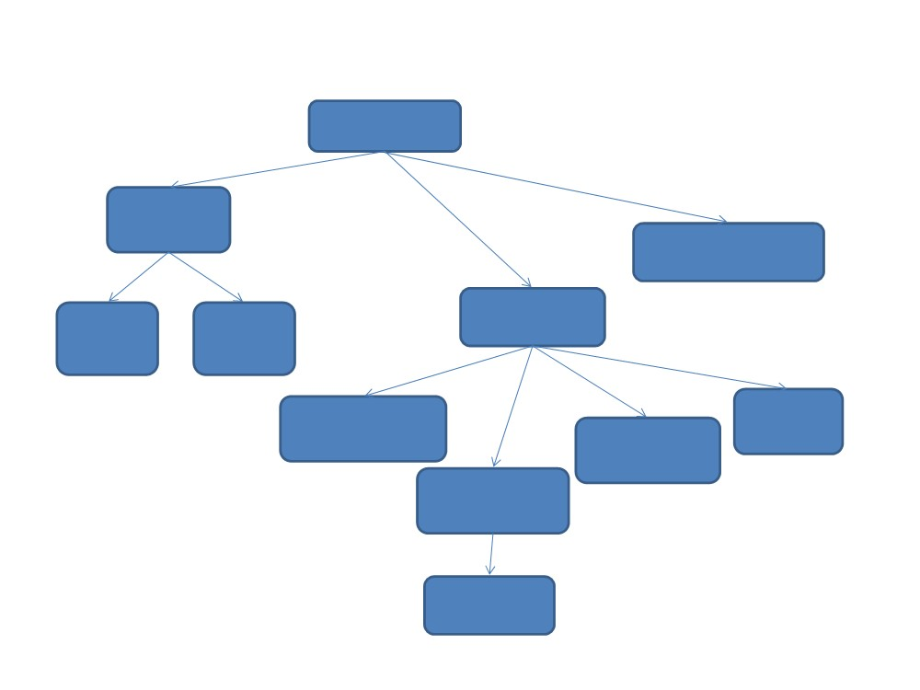
1.2.1 Stubs and Drivers
SATM system
Terminal
I/O
Central Bank Communication
Manage Sessions
Screen Key Driver Sensor
Close
Validate Card
Manage Session Transaction
Validate PIN
Get Digit

Slide 15
Contents
1. Different levels of testing.
o Unit Testing
o Integration Testing o System Testing o Acceptance Testing o Regression Testing
2. Important factors on testing levels.
o Factors influencing test scope
o Why test at different levels?
3. Test levels and software life‐cycle models.
o
“V” Model

Slide 16
1.3 System Testing
• Test of overall interaction of components
• Find disparities between implementation and specification
• Usually where most resources go to
• Involves - load, performance, reliability and security testing

Slide 17
1.3 System Testing
• Who performs system testing and when is it done?
- Done by the test team
- Test cases written when high level design spec is ready
• Where is it done?
- Done on a system test machine
- Usually in a simulated environment e.g. vmware

Slide 18
1.3.1 System vs. Integration testing
• What vs. How
• Requirement spec‐> what
• detailed design spec‐>how
• System testing functional not structural

Slide 19
1.3.2 Example: System/Integration Testing
SATM system
Terminal
I/O
Central Bank Communication
Manage Sessions
Screen Key Driver Sensor
Close
Validate Card
Manage Session Transaction
Validate PIN
Get Digit

Slide 20
Contents
1. Different levels of testing.
o Unit Testing
o Integration Testing o System Testing o Acceptance Testing o Regression Testing
2. Important factors on testing levels.
o Factors influencing test scope
o Why test at different levels?
3. Test levels and software life‐cycle models.
o
“V” Model

Slide 21
1.4 Acceptance Testing
• Demonstrates satisfaction of user
• Users are essential part of process
• Usually merged with System Testing
• Done by test team and customer
• Done in simulated environment/real environment

Slide 22
Contents
1. Different levels of testing.
o Unit Testing
o Integration Testing o System Testing o Acceptance Testing o Regression Testing
2. Important factors on testing levels.
o Factors influencing test scope
o Why test at different levels?
3. Test levels and software life‐cycle models.
o
“V” Model

Slide 23
1.5 Regression Testing
• On going process throughout testing lifecycle
• New bug‐fix breaks previously tested units?
• Perform regression test whenever program changes
Regression testing is the process of testing changes to computer programs to make sure that the older programming still works with the new changes. Regression testing is a normal part of the program development process and, in larger companies, is done by code testing specialists.

Slide 24
Contents
1. Different levels of testing.
o Unit Testing
o Integration Testing o System Testing o Acceptance Testing o Regression Testing
2. Important factors on testing levels.
o Factors influencing test scope
o Why test at different levels?
3. Test levels and software life‐cycle models.
o
“V” Model

Slide 25
2.1 Factors influencing test scope
• Size of project
• Complexity of project
• Budget for project
• Time scope for project
• Number of staff

Slide 26
2.2 Why test at different levels
• Software development naturally split to phases
• Easily track bugs
• Ensures a working subsystem/ component/ library
• Software reuse more practical

Slide 27
Contents
1. Different levels of testing.
o Unit Testing
o Integration Testing o System Testing o Acceptance Testing o Regression Testing
2. Important factors on testing levels.
o Factors influencing test scope
o Why test at different levels?
3. Test levels and software life‐cycle models.
o
“V” Model

Slide 28
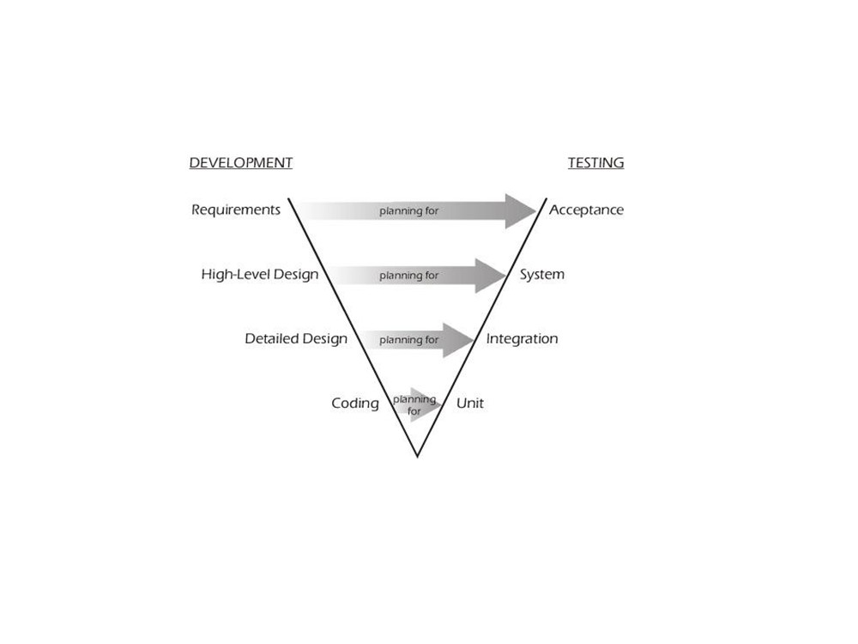
3.1 The “V” model and test levels
Fig 3.1 levels of testing

Slide 29
Summary
• Different levels of test
• Unit testing
• Integration testing
• System testing
• Acceptance testing
• Regression testing
• Factors affecting test scope
• Why test at different levels
• The “V” model and testing

Slide 30
Life Cycle Models

Slide 31
Definition. A (software/system) lifecycle model is a description of the sequence of activities carried out in an SE project, and the relative order of these activities
It provides a fixed generic framework that can be tailored to a specific project.
Project specific parameters will include:
• Size, (person-years)
• Budget,
• Duration.
project plan = lifecycle model + project parameters

Slide 32
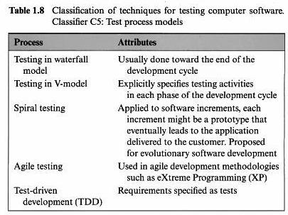

Slide 33
Testing in the waterfall model:
The waterfall model is one of the earliest and least used, software life cycle.
Figure 1.23 shows different phases in a development process based on the waterfall model. While verification and validation of documents produced in each phase is an essential activity, static as well as dynamic testing occurs toward the end of the process.
Waterfall model requires adherence to an inherently sequential process, defects introduced in the early phases and discovered in the later phases could be costly to correct.
There is a very little iterative or incremental development when using the waterfall model.
Advantages
1. Easy to understand and implement.
2. Widely used and known (in theory!)
3. Reinforces good habits: define-before-design, design-before-code
4. Identifies deliverables and milestones
5. Document driven, URD, SRD, … etc. Published documentation standards, e.g. PSS-05.
6.Works well on mature products and weak teams.

Slide 34
Disadvantages:
1.Idealised, doesn’t match reality well.
2.Doesn’t reflect iterative nature of exploratory development.
3.Unrealistic to expect accurate requirements so early in project
4.Software is delivered late in project, delays discovery of serious errors.
5. Difficult to integrate risk management
6.Difficultand expensive to make changes to documents, ”swimming upstream”.
7.Significant administrative overhead, costly for small teams and projects

Slide 35
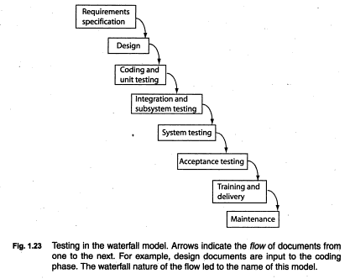

Slide 36
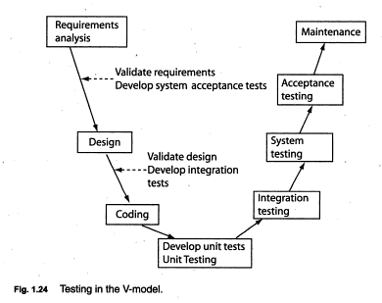
Testing in the V-model: The v-model, as shown in the fig, explicitly specifies testing activities associated with each phase of the development cycle. These activities begin from the start and continue until the end of life cycle. The testing activities are carried out parallel with the development activities

Slide 37
Spiral testing:
The term spiral testing is not to be confused with spiral model, through they both are similar in that both can be visually represented as a spiral of activities.
In the spiral testing, the sophisticated of testing of test activities increases with the stages of an evolving prototype.
In the early stages, when a prototype is used to evaluate how an application must evolve, one focuses on test planning. The focus at this stage is on how testing will be performed in the remainder of the project.
Subsequent iterations refine the prototype based on more precise set of requirements.
Further test planning takes place and unit & integration tests are performed.
In the final stage ,when the requirements are well defined, testers focus on system and acceptance testing.

Slide 38
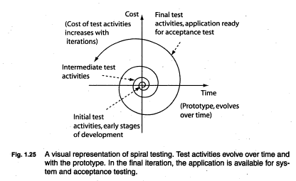

Slide 39
Advantages
1.Realism: the model accurately reflects the iterative nature of software development on projects with unclear requirements
2.Flexible: incoporates the advantages of the water fall and rapid prototyping methods
3.Comprehensive model decreases risk
4.Good project visibility
Disadvantages
•Needs technical expertise in risk analysis to really work
•Model is poorly understood by non-technical management, hence not so widely used
•Complicated model, needs competent professional management. High administrative overhead

Slide 40
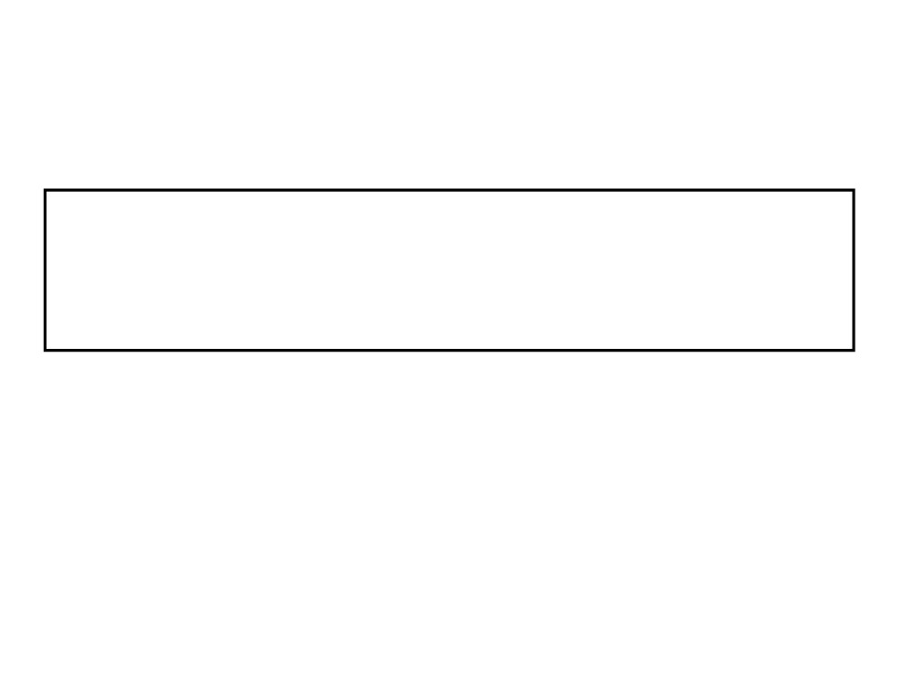
Rapid Prototyping
Key idea: Customers are non-technical and usually don’t know what they want/can have.
Rapid prototyping emphasises requirements analysis and validation, also called:
• customer oriented development,
• evolutionary prototyping

Slide 41
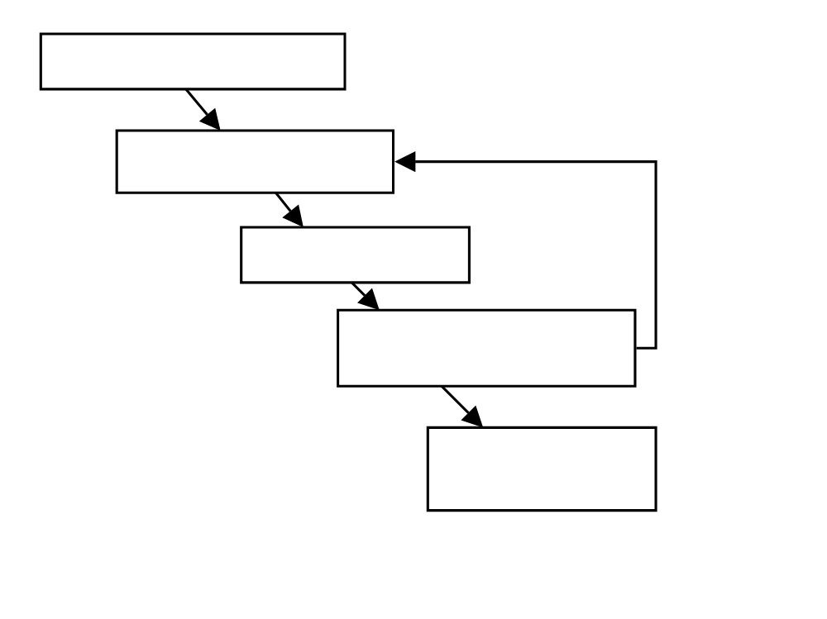
Requirements Capture
Iterate
Quick Design
Build Prototype
Customer Evaluation of Prototype
The Rapid Prototype Workflow
Engineer Final Product

Slide 42

Advantages
1. Reduces risk of incorrect user requirements
2. Good where requirements are
changing/uncommitted
3. Regular visible progress aids management
4. Supports early product marketing

Slide 43
Disadvantages
1. An unstable/badly implemented prototype often becomes the final product.
2. Requires extensive customer collaboration
- Costs customers money
- Needs committed customers
- Difficult to finish if customer withdraws
- May be too customer specific, no broad market

Slide 44
Disadvantages
3. Difficult to know how long project will last
4. Easy to fall back into code-and-fix without proper requirements analysis, design, customer evaluation and feedback.

Slide 45
Agile testing: Agile testing involves in addition to the usual steps such as test planning, test design and test execution. Agile testing promotes the following ideas:
Include testing -related activities throughout a development project starting from the requirement phase.
Work collaboratively with the customer who specifies requirements in terms of tests.
testers and development must collaborate with each other rather than serve as adversaries and
Test often and in small chunks.

Slide 46
Agile (XP) Manifesto
XP = Extreme Programming emphasises:
• Individuals and interactions
- Over processes and tools
• Working software
- Over documentation
• Customer collaboration
- Over contract negotiation
• Responding to change
- Over following a plan

Slide 47
Agile Principles (Summary)
• Continuous delivery of software
• Continuous collaboration with customer
• Continuous update according to changes
• Value participants and their interaction
• Simplicity in code, satisfy the spec

Slide 48
XP Practices (Summary)
• Programming in pairs
• Test driven development
• Continuous planning, change , delivery
• Shared project metaphors, coding standards and ownership of code
• No overtime

Slide 49
Advantages
• Lightweight methods suit small-medium size projects
• Produces good team cohesion
• Emphasises final product
• Iterative
• Test based approach to requirements and quality assurance

Slide 50
COTS
• COTS =
Commercial Off-The-Shelf software
• Engineer together a solution from existing commercial software packages using minimal software ”glue”.
• E.g. using databases, spread sheets, word proccessors, graphics software, web browsers, etc.

Slide 51
Advantages
• Fast, cheap solution
• May give all the basic functionality
• Well defined project, easy to run
Disadvantages
• Limited functionality
• Licensing problems, freeware, shareware, etc.
• License fees, maintainance fees, upgrade compatibility problems

Slide 52
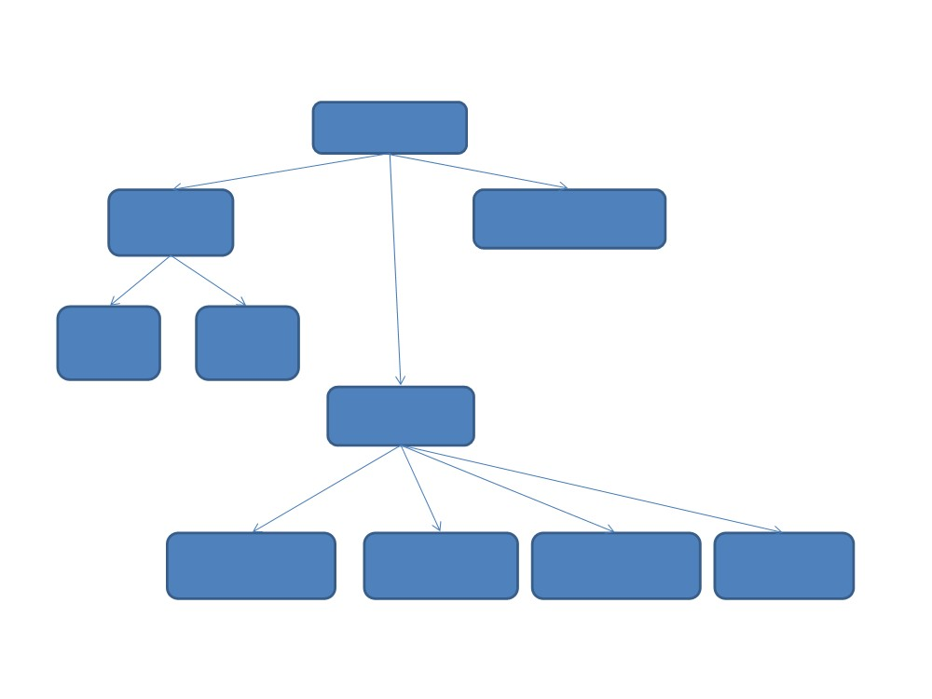
Decomposition tree of SATM
SATM system
Terminal I/O
Central Bank Communication
Screen Key
Driver Sensor
Manage Sessions
Validate Card
Manage Close PIN Entry
Transaction Session

Slide 53
1.2.1 Stubs and Drivers
SATM system
Terminal
I/O
Central Bank Communication
Manage Sessions
Screen Key Driver Sensor
Close
Validate Card
Manage Session Transaction
Validate PIN
Get Digit

Slide 54
1.3.2 Example: System/Integration Testing
SATM system
Terminal
I/O
Central Bank Communication
Manage Sessions
Screen Key Driver Sensor
Close
Validate Card
Manage Session Transaction
Validate PIN
Get Digit

Slide 55
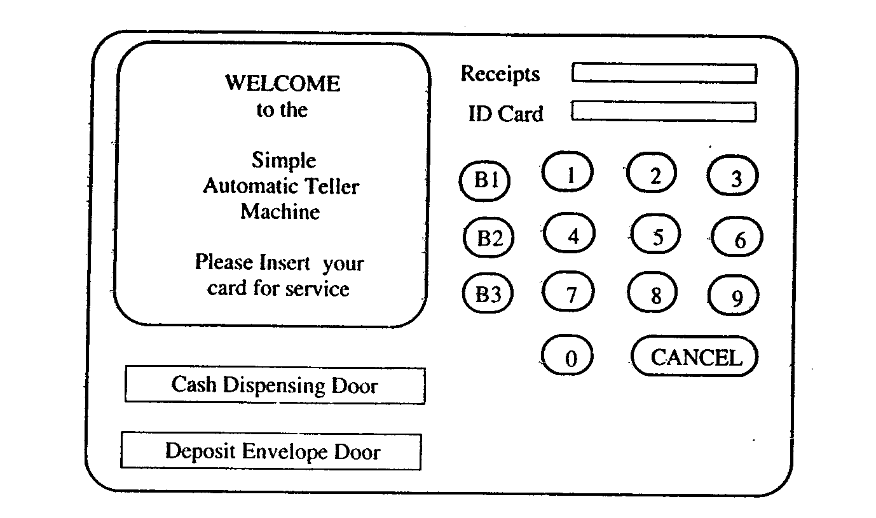

Slide 56
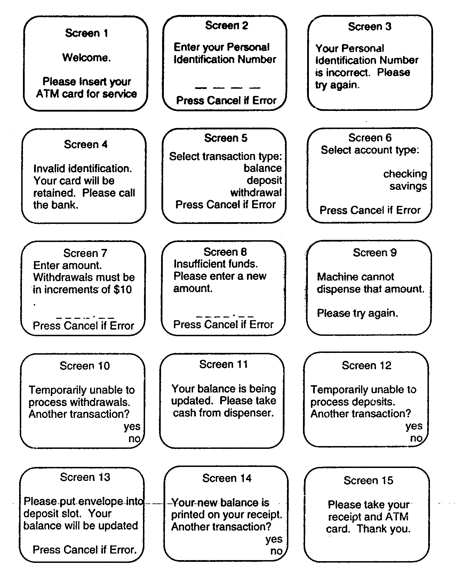

Slide 57
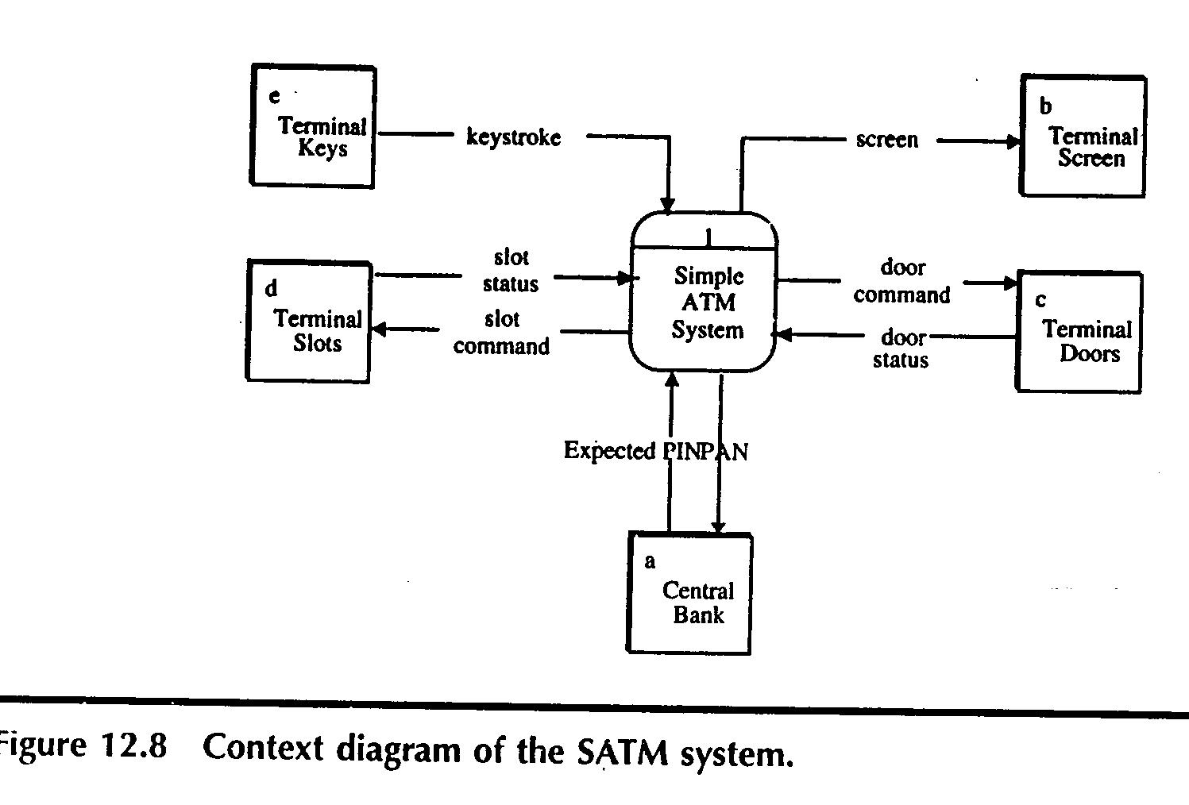

Slide 58
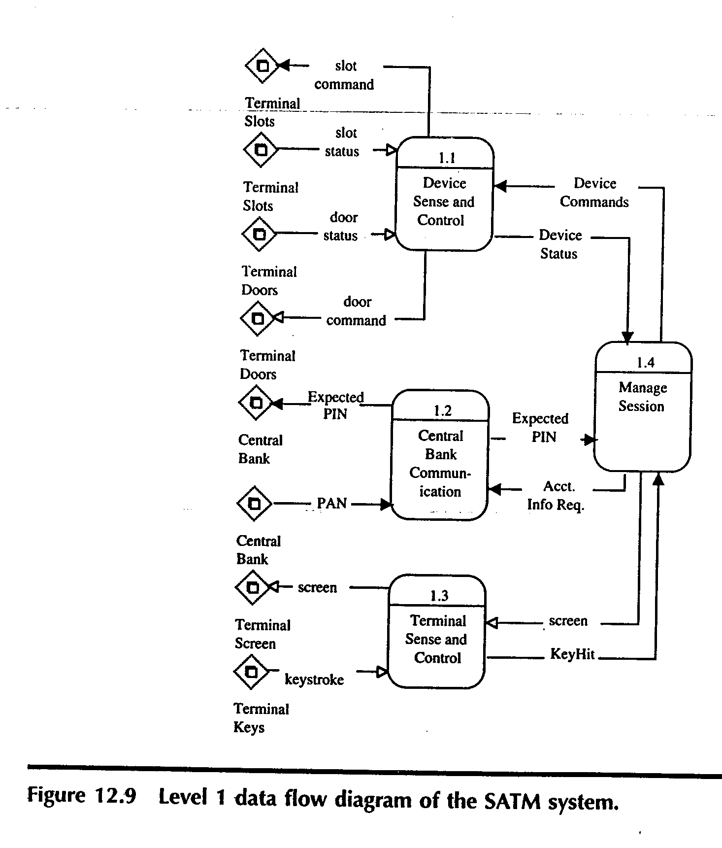

Slide 59
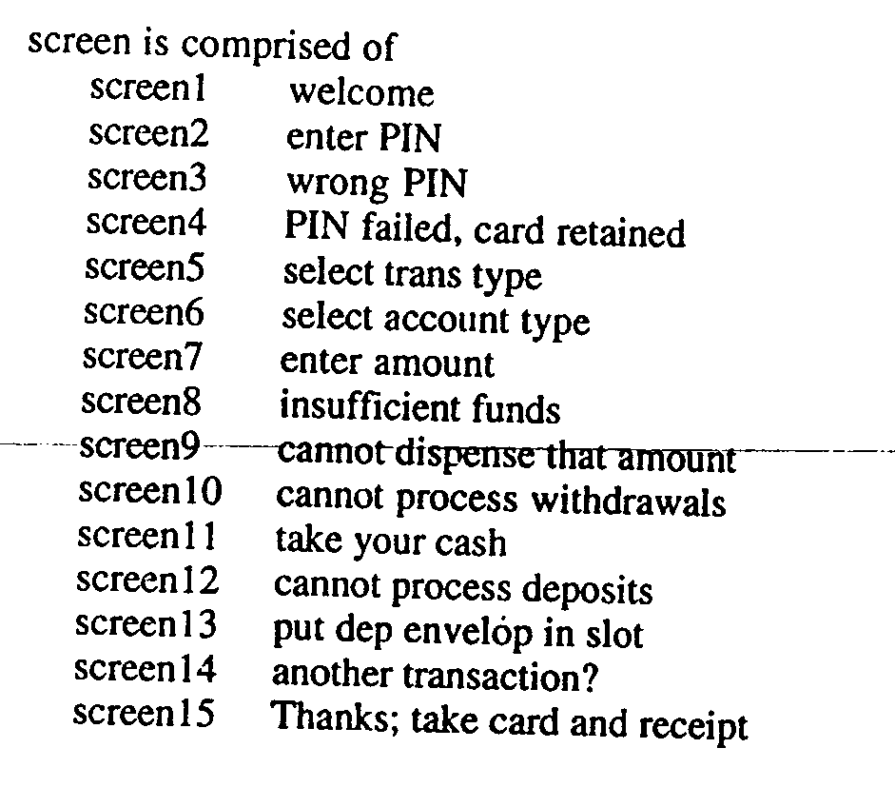

Slide 60
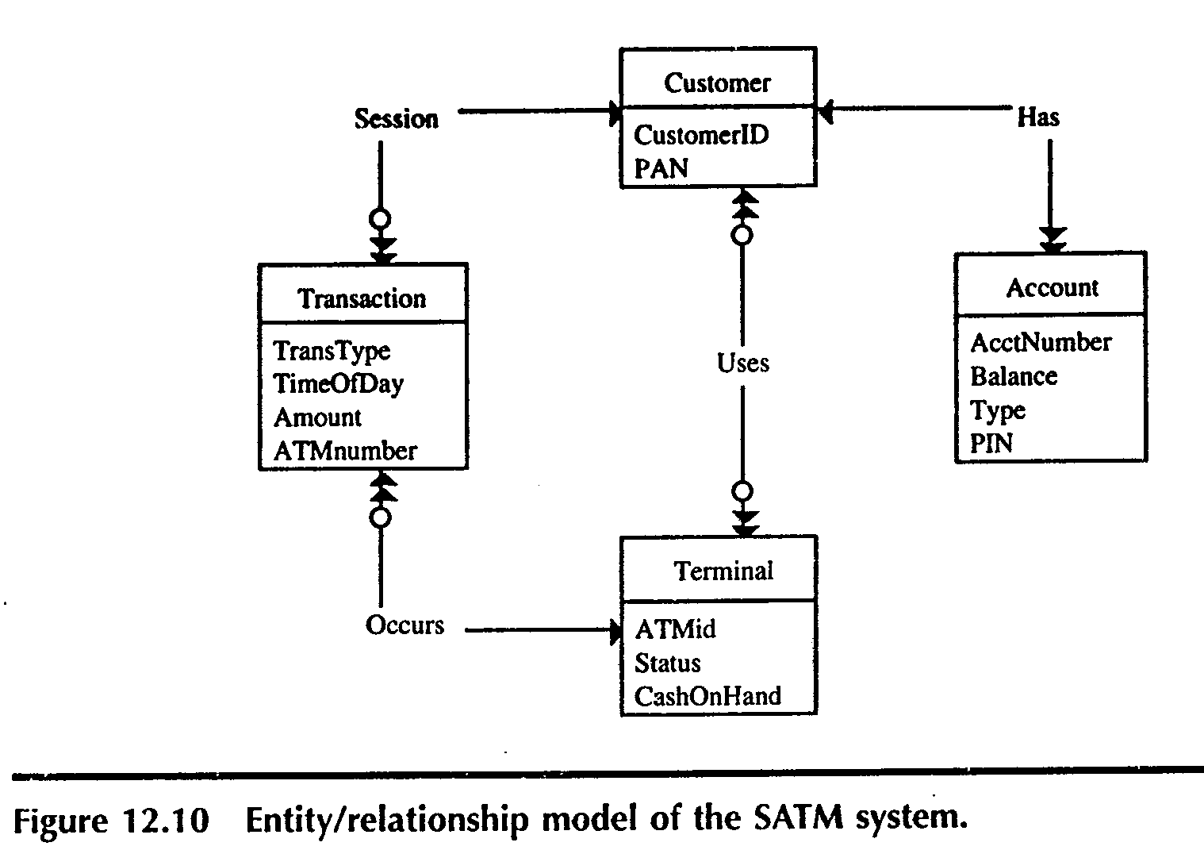

Slide 61
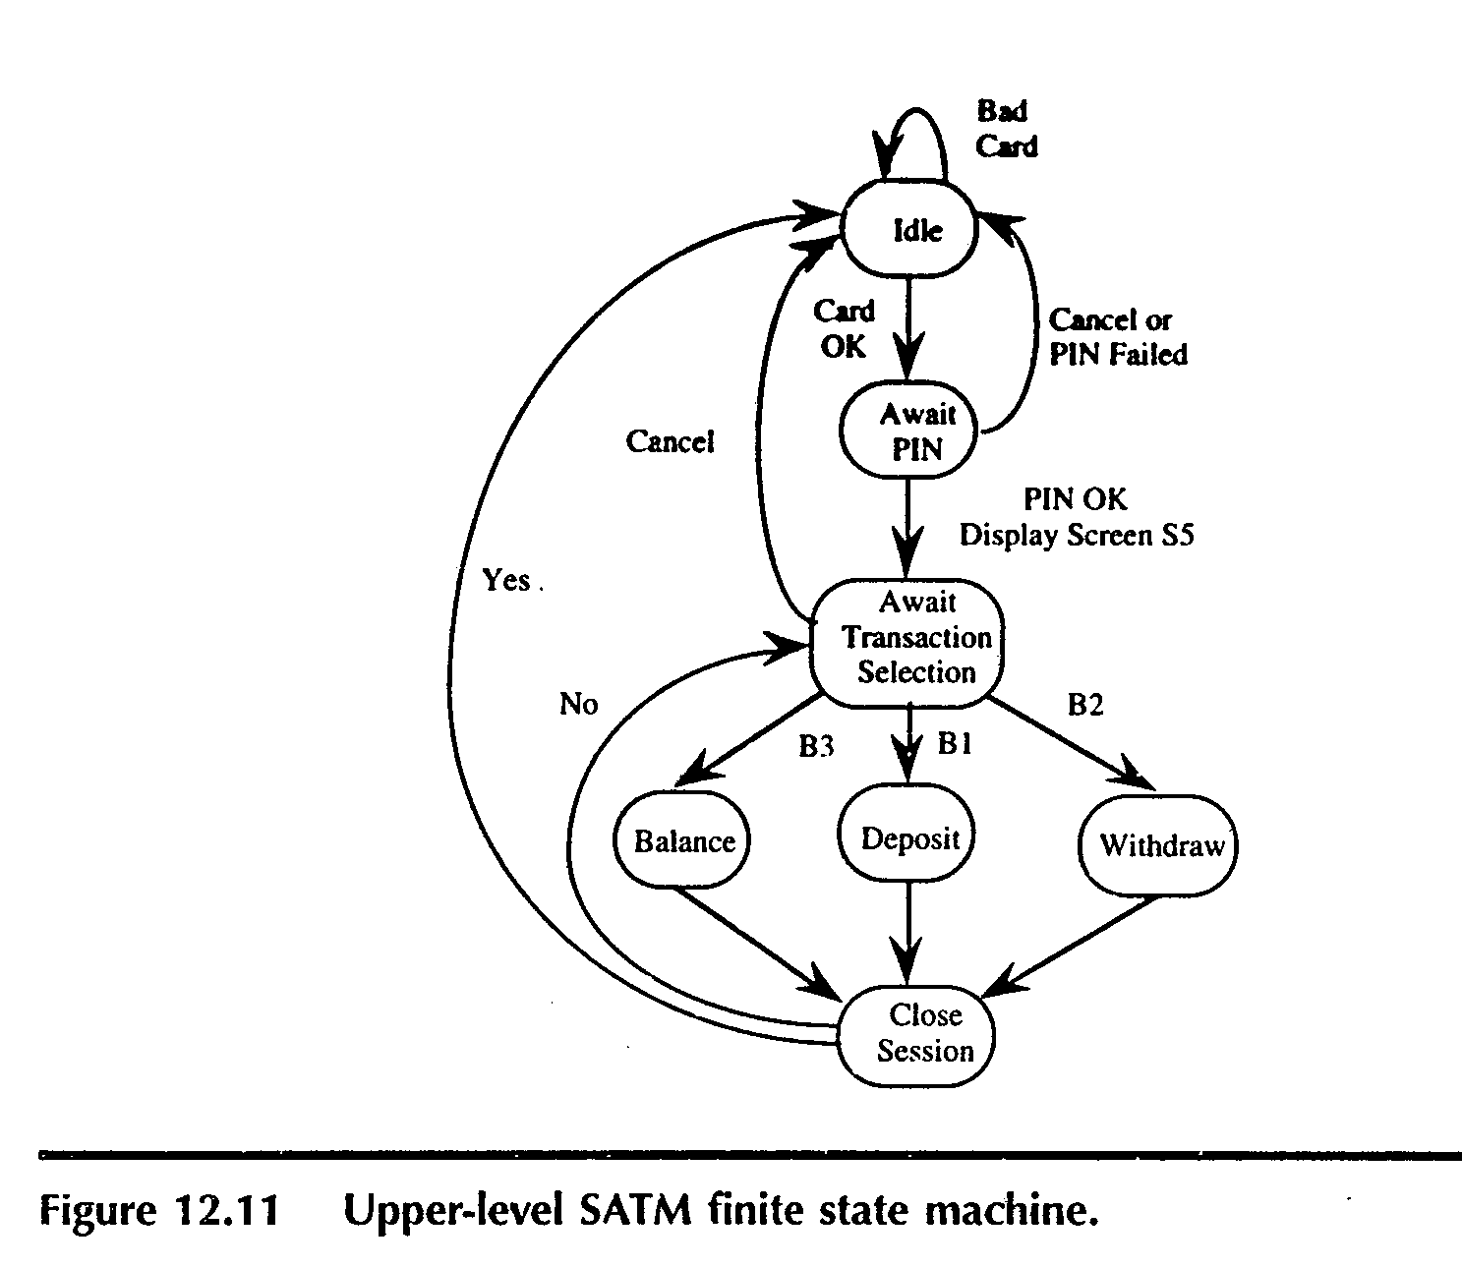

Slide 62
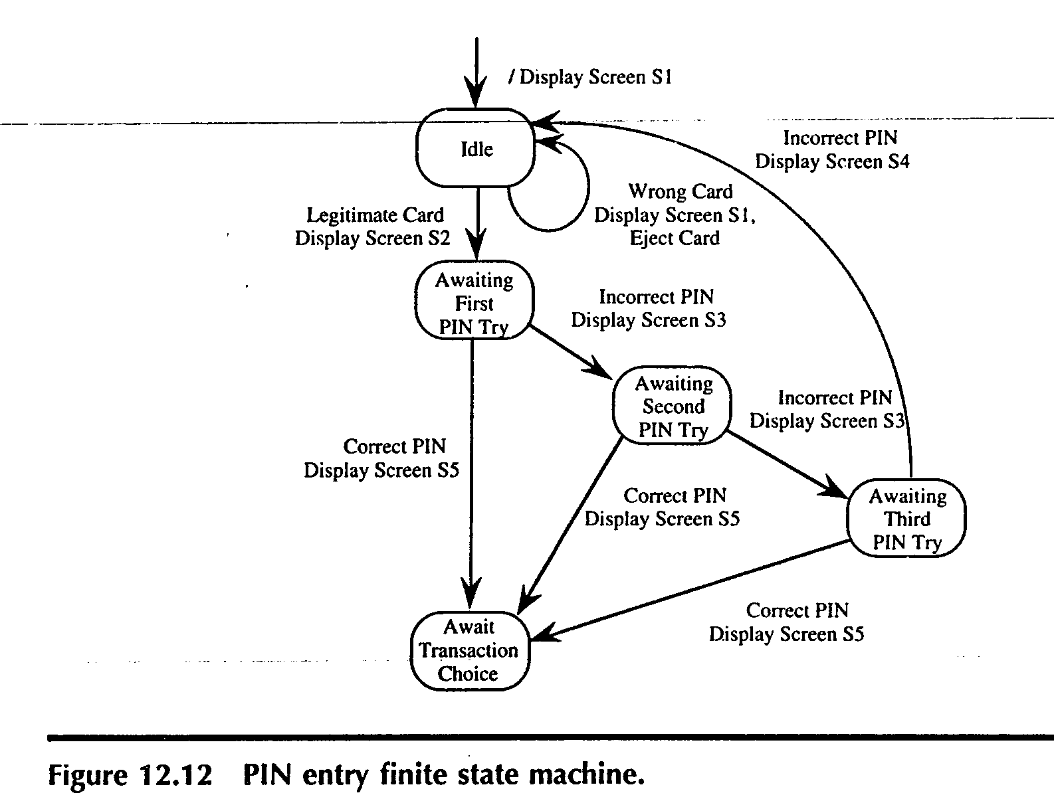

Slide 63
